Slide 1


Nelson MASANGANISE
17/05/2025

Slide 2

Outline
Executive Summary
Introduction
Methodology
Results
Conclusion
Appendix

Slide 3
Executive Summary
In this capstone, we will predict if the SpaceX Falcon 9 first stage will land successfully.
If we can determine if the first stage will land, we can determine the cost of a launch.
The methodology used in this project involves:
Data collection and data wrangling
Exploratory data analysis
Data visualization
Model development and model evaluation
Reporting your results to stakeholders.
The results of this project showed us that some rocket launch features are correlated to the outcome of the launch on whether is a success or failure.

Slide 4
Introduction
Space Y that would like to compete with SpaceX founded by Billionaire industrialist Allon Musk.
SpaceX advertises Falcon 9 rocket launches on its website with a cost of 62 million dollars; other providers cost upwards of 165 million dollars each, much of the savings is because SpaceX can reuse the first stage.
Therefore if we can determine if the first stage will land, we can determine the cost of a launch.
We will also determine if SpaceX will reuse the first stage.
We will train a machine learning model and use public information to predict if SpaceX will reuse the first stage.

Slide 5

Section 1

Slide 6
Methodology
Executive Summary
Data collection methodology:
SpaceX launch data was gathered from an API, specifically the SpaceX REST API.
Falcon 9 Launch data was obtained by web scraping related Wiki pages.
Perform data wrangling:
Calculate the number of launches on each site.
Calculate the number and occurrence on each orbit and the number and occurrence of mission outcome of the orbits.
Convert the landing outcomes to Classes y (either 0 or 1).
0 is a bad outcome, that is, the booster did not land. 1 is a good outcome, that is, the booster did land.
The variable Y will represent the classification variable that represents the outcome of each launch.

Slide 7
Methodology
Executive Summary
Perform exploratory data analysis (EDA) using visualization and SQL:
Create scatter plots and bar charts by writing Python code to analyse data in a Pandas data frame
Write Python code to conduct exploratory data analysis by manipulating data in a Pandas data frame
Create and execute SQL queries to select and sort data
Utilize data visualization skills to visualize the data and extract meaningful patterns to guide the modelling process.

Slide 8
Methodology
Executive Summary
Perform predictive analysis using classification models:
Build a machine learning pipeline to predict if the first stage of the Falcon 9 lands successfully.
This will include:
Preprocessing, allowing us to standardize our data.
Train_test_split, allowing us to split our data into training and testing data.
Train the model and perform Grid Search, allowing us to find the hyperparameters that allow a given algorithm to perform best
Use the best hyperparameter values to determine the model with the best accuracy using the training data.
The following models will be tested: Logistic Regression, Support Vector machines, Decision Tree Classifier, and K-nearest neighbors
Plot the confusion matrix to evaluate the performance of the models.

Slide 9
Data Collection
SpaceX REST API gave us data about launches, including information about the rocket used, payload delivered, launch specifications, landing specifications, and landing outcome.
Web scrapping was used to scrape Falcon 9 Launch data from related Wiki pages.
The flowcharts are as follows:
Web scrapping Falcon 9 data
Request and parse the SpaceX launch data using the GET request
Filter the dataframe to only include Falcon 9 launches
Replace missing values
Request the Falcon9 Launch Wiki page from its URL
Extract all column/variable names from the HTML table header using BeautifulSoup
Parse the table and convert it into a Pandas dataframe
SpaceX Rest API

Slide 10
Data Collection – SpaceX API
The steps for data collection using the SpaceX REST API are shown in the flow diagram.
The response content is decoded using .json and is turned into a Pandas dataframe using .json_normalize()
The completed notebook is available on this URL: Data Collection API
HTTP Request rocket launch data
from SpaceX using a URL
Check response content (JSON)
Status code

Slide 11
Data Collection - Scraping
The steps for data collection by scrapping the ‘List of Falcon 9 and Falcon Heavy launches’ Wikipage are shown in the flow diagram.
The completed notebook is available on this URL: Data Collection with Web Scrapping
Perform HTTP GET method
to request Falcon9 Launch HTML page
Assign response to an object
Status code
Create a BeautifulSoup from
the HTML response
Extract all column/variable names from
the HTML table header
Create a dataframe by parsing
The launch HTML tables

Slide 12
Data Wrangling
Exploratory Data Analysis
Calculate no# of launches.
Determine Training Labels
Create a landing outcome label from Outcome column.
Calculate the no# and occurrence of each orbit
Calculate the no# and occurrence of mission outcome of the orbits.
Determine the success rate.
Once the data was collected, we performed data wrangling as per the steps shown in the process flow.
The completed notebook is available on this URL: Data Wrangling

Slide 13
EDA with Data Visualization
Pandas and Matplotlib were used perform exploratory Data Analysis and Feature Engineering
The charts listed below were used in this step and the completed notebook is available on the following URL: EDA
Type of Chart | Reason
Scatter plot | To see how the FlightNumber and Payload variables would affect the launch outcome. To visualize the relationship between Flight Number and Launch Site. To visualize the relationship between Payload Mass and Launch Site. To visualize the relationship between FlightNumber and Orbit type. To visualize the relationship between Payload Mass and Orbit type.
Bar chart | To visualize the relationship between success rate of each orbit type.
Line chart | To visualize the launch success yearly trend.

Slide 14
EDA with SQL
Several SQL queries were performed in this step to achieve the following:
Display the names of the unique launch sites in the space mission using DISTINCT.
Display the total payload mass carried by boosters launched by NASA (CRS).
Display average payload mass carried by booster version F9 v1.1
List the date when the first successful landing outcome in ground pad was achieved.
List the total number of successful and failure mission outcomes.
List all the booster_versions that have carried the maximum payload mass.
List the records which will display the month names, failure landing_outcomes in drone ship ,booster versions, launch_site for the months in year 2015.
Rank the count of landing outcomes (such as Failure (drone ship) or Success (ground pad)) between the date 2010-06-04 and 2017-03-20, in descending order.
The complete notebook is available here: EDA SQL

Slide 15
Build an Interactive Map with Folium
To mark all launch sites on a map, we used the following objects: Map, Circle, and Marker.
To mark the success/failed launches for each site on the map, we used the following objects: MarkerCluster.
To calculate the distances between a launch site to its proximities, we used th following objects: Marker and PolyLine.
The complete notebook can be found here: Map with Folium

Slide 16
Build a Dashboard with Plotly Dash
For the dashboard, we added a Launch Site Drop-down Input Component. This is required to select one specific site and check its detailed success rate (class=0 vs. class=1).
We also added a callback function to render success-pie-chart based on selected site dropdown.
To select the Payload, we added a Range Slider. This enables us to find whether the variable payload is correlated to mission outcome.
We added a callback function to render the success-payload-scatter-chart scatter plot. This enables use to visually observe how payload may be correlated with mission outcomes for selected site(s).
The completed notebook can be found here: Dashboard with Plotly Dash

Slide 17
Predictive Analysis (Classification)
The model development process adopted for this step is summarized below.
The models tested in this step include SVM, Classification Trees, and Logistic Regression.
The complete notebook is available here: Machine Learning
Import libraries and define auxiliary functions
Load the dataframe
Create a column for the Class
Standardize the data
Split into training and test data
Find the best hyperparameter for the ML algorithms
Find best algorithm best using test data

Slide 18
Results
It was noted from the EDA that the launch success rate since 2013 kept increasing till 2020.
This was based on the EDA using Pandas.
From the EDA using SQL, it was observed that 5 boosters have success in drone ship and have payload mass greater than 4000 kg but less than 6000 kg.

Slide 19
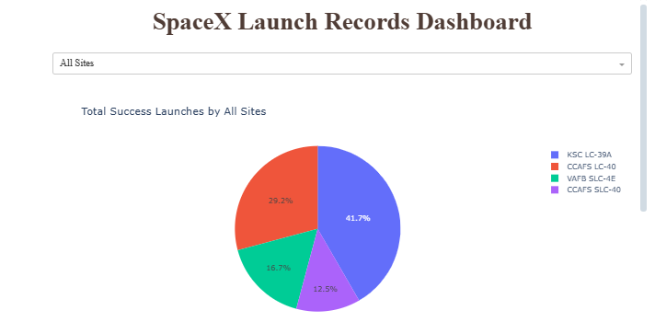
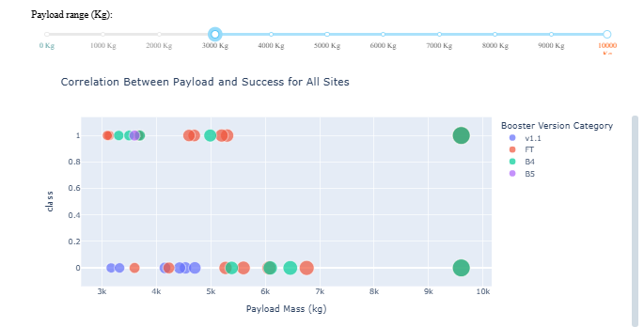
Results
Interactive analytics demo in screenshots

Slide 20
Results
The following results were obtained from the predictive analysis results:
18 records were in the test sample.
The sigmoid kernel had the best result on the validation dataset using the SVM.
The data accuracy achieved for the decision tree classifier using the validation data was 83.33%

Slide 21

Section 2

Slide 22
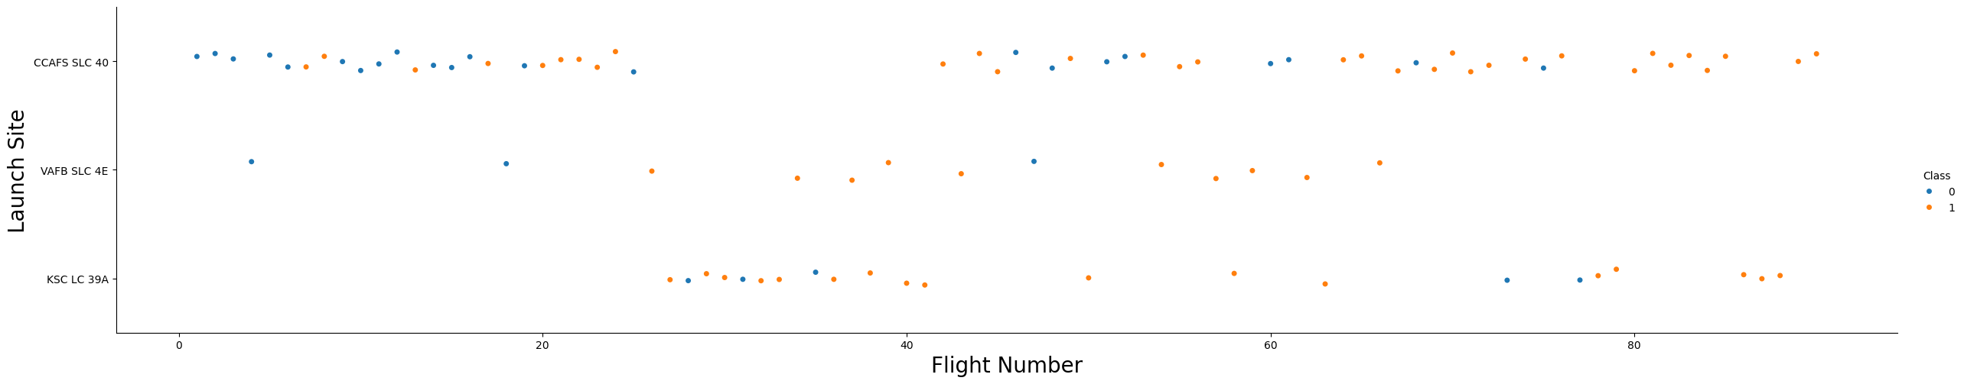
Flight Number vs. Launch Site
It can be seen that the higher the number of flights at a launch site, the higher the successful launches.
Furthermore, the CCAFS SLC 40, had a balanced number of flights ranging from 1 up to > 80.

Slide 23
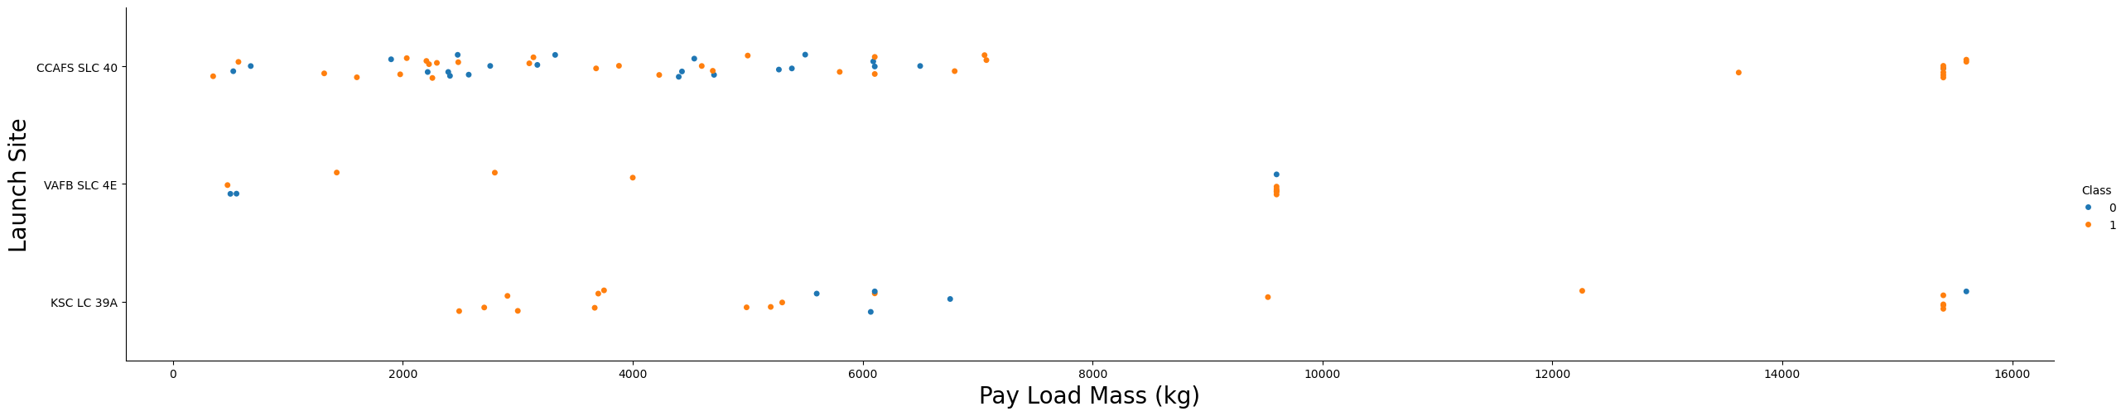
Payload vs. Launch Site
For the VAFB-SLC launch site there are no rockets launched for heavy payload mass (greater than 10000 kg).
The CCAFS-SLC launch site exhibited more successful launches at higher payloads > 12300 kg compared to other sites.

Slide 24
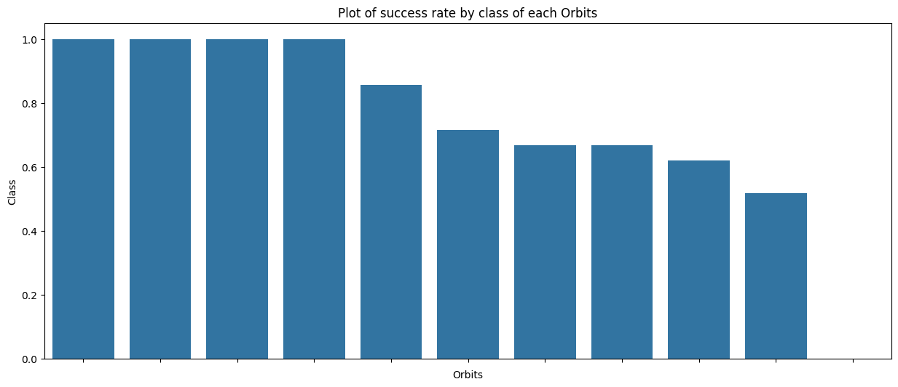
Success Rate vs. Orbit Type
Orbits ES-L1, SSO, HEO and GEO exhibited a 100% successful launch rate.

Slide 25
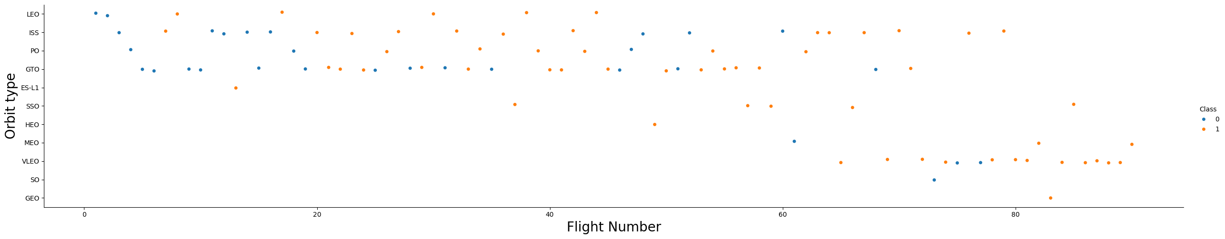
Flight Number vs. Orbit Type
The LEO orbit, success seems to be related to the number of flights.
Conversely, in the GTO orbit, there appears to be no relationship between flight number and success.

Slide 26
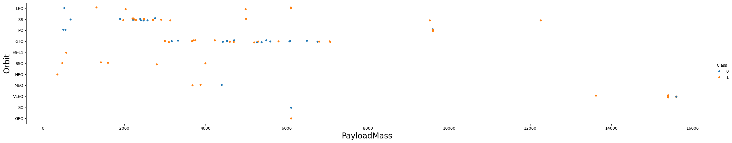
Payload vs. Orbit Type
The successful landing or positive landing rate are more for Polar, LEO, and ISS considering heavy payloads.
However, for GTO, it's difficult to distinguish between successful and unsuccessful landings as both outcomes are present.

Slide 27
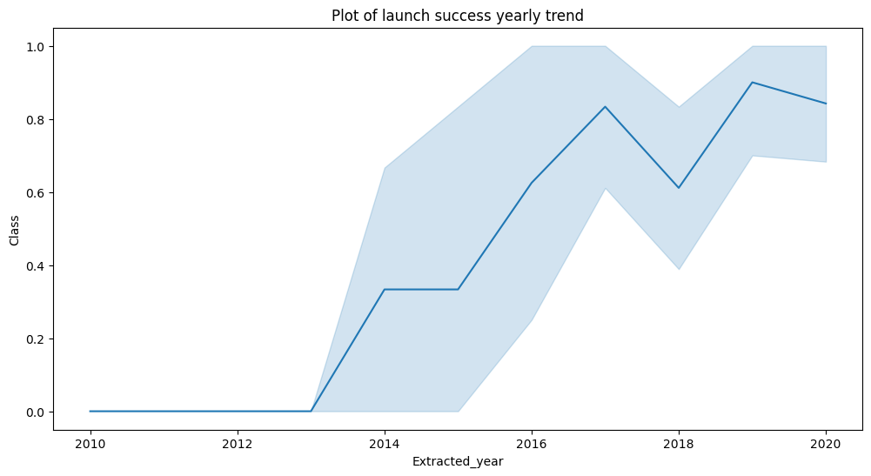
Launch Success Yearly Trend
We can observe that the sucess rate since 2013 kept increasing till 2020.
In addition, a steep increase is noted between 2013 and 2014.

Slide 28
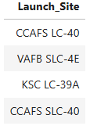
All Launch Site Names
The names of the unique launch sites are listed in the table below.
Only 4 launch sites were considered in this project.

Slide 29
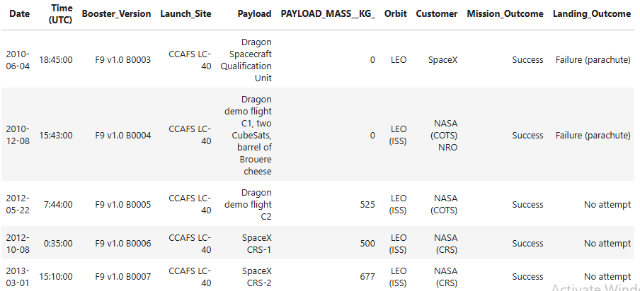
Launch Site Names Begin with 'CCA'
The first 5 launch site names beginning with ‘CCA’ are listed below.

Slide 30
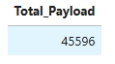
Total Payload Mass
The total payload carried by boosters from NASA was 45 596 kg.

Slide 31
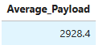
Average Payload Mass by F9 v1.1
The average payload mass carried by booster version F9 v1.1 was 2928.4 kg.

Slide 32
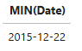
First Successful Ground Landing Date
The date of the first successful landing outcome on ground pad was 22 December 2015.

Slide 33
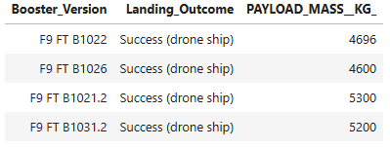
Successful Drone Ship Landing with Payload between 4000 and 6000
The names of boosters which have successfully landed on drone ship and had payload mass greater than 4000 but less than 6000 are listed below.

Slide 34
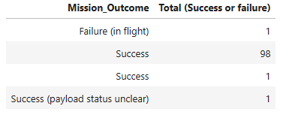
Total Number of Successful and Failure Mission Outcomes
The total number of successful and failure mission outcomes are shown below.

Slide 35
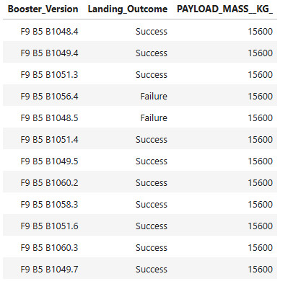
Boosters Carried Maximum Payload
The names of the booster which have carried the maximum payload mass are as follows:

Slide 36
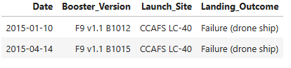
2015 Launch Records
The failed landing_outcomes in drone ship, their booster versions, and launch site names for in year 2015 are only 2 as shown below.

Slide 37
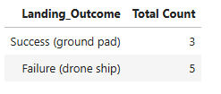
Rank Landing Outcomes Between 2010-06-04 and 2017-03-20
The table below ranks the count of landing outcomes (such as Failure (drone ship) or Success (ground pad)) between the date 2010-06-04 and 2017-03-20, in descending order.

Slide 38

Section 3

Slide 39
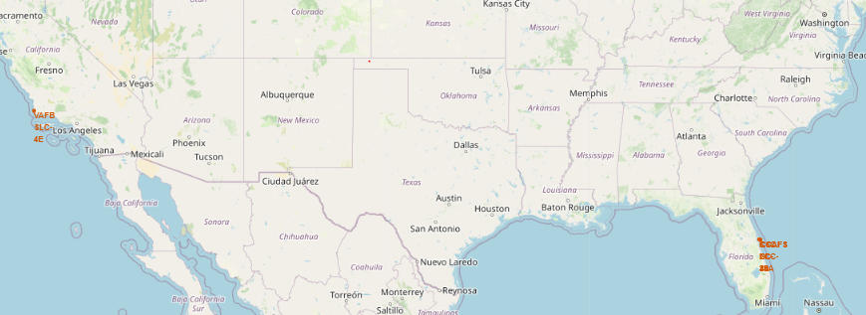
Launch Site Locations
The launch sites were located to the west and east of the USA.

Slide 40
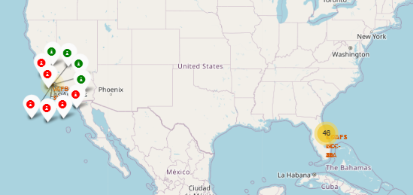
Success/Failed Launches for Each Site
Successful launches are indicated in green, whereas failed launches are indicated in red.

Slide 41
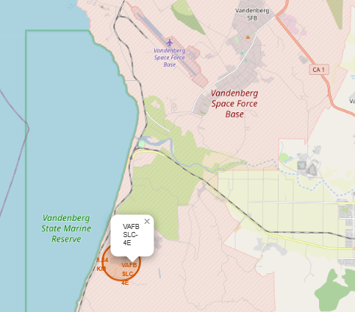
Map with Proximities
Landmarks shown on the map include railway and airforce base.

Slide 42

Section 4

Slide 43
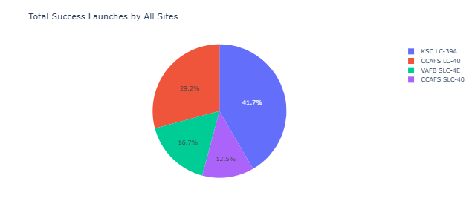
Total Success Launches by All Sites
KSC LC-39A had the highest percentage of successful launches at 41.7% followed by CCAFS LC-40 at 29.2%.

Slide 44
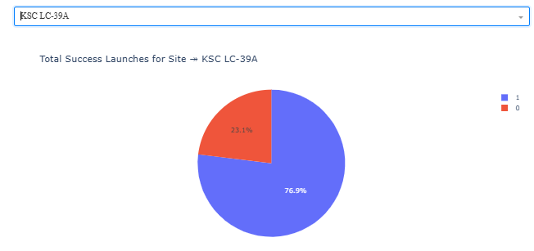
Launch Site with Highest Launch Success Ratio
KSC LC-39A had a launch success ratio of 76.9% to 23.1%.

Slide 45
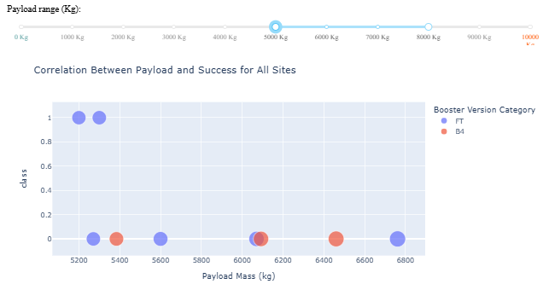
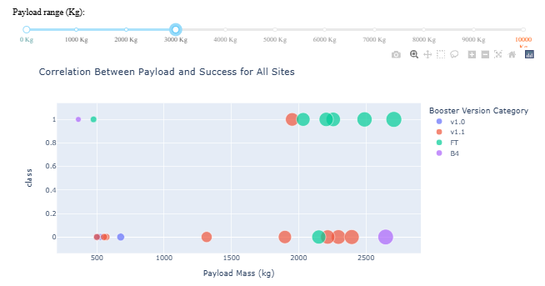
Payload vs. Launch Outcome
We can see that as the payload increases, the number of sites with a correlation between the payload and success launch reduces.

Slide 46

Section 5

Slide 47
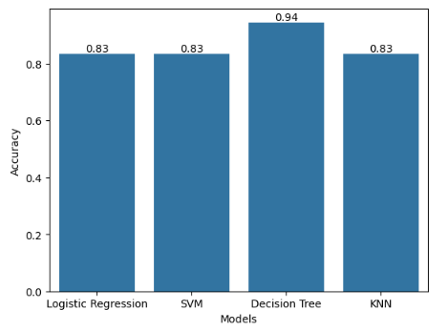
Classification Accuracy
The Decision Tree model exhibited the highest accuracy at 94%.

Slide 48
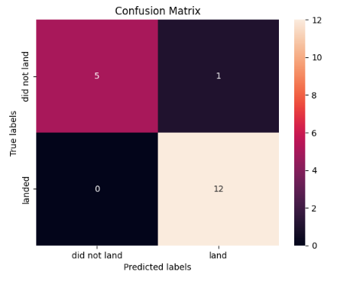
Confusion Matrix
Show the confusion matrix of the best performing model with an explanation

Slide 49
Conclusions
For orbit types ES-L1, SSO, HEO, and GEO, there is a 100% success rate in landing there.
The decision tree algorithm is the preferred algorithm to predict successful launches.
The higher the number of flights at a launch site, the higher the successful launches.
The CCAFS-SLC launch site exhibited more successful launches at higher payloads > 12300 kg compared to other sites.

Slide 50
Appendix
The Python code snippets, SQL queries, charts, Notebook outputs, or data sets that were used in this project are available on Github.

Slide 51


